Slide 1
TRAVEL- JOURNAL
Database project
Team:
Sravani Koppala
Vichetna Gadam
Snehal Gaikwad

Slide 2
Description:
Travel - Journal is a simple, easy to use web-application where a ‘User’ can register initially for gainig access and then login with those credentials. A registered ‘User’ can :
post about his/her Vacation/Holiday Trips
also access a Personal Diary and
create a ‘To Do List’ while on the go.

Slide 3
SYSTEM REQUIREMENTS:
1. System environment: Web application
2. Operating system: Windows 10, 64-bit
3. Programming environment and Languages:
a. Programming language: PHP
b. Web designing: HTML, BootStrap
c. Database : MYSQL
d. Server: Wamp server package

Slide 4
In our TRAVEL-JOURNAL app we have the following entities
USER
TRIPS
ATTRACTIONS
PERSONAL_DIARY
TO_DO_LIST

Slide 5
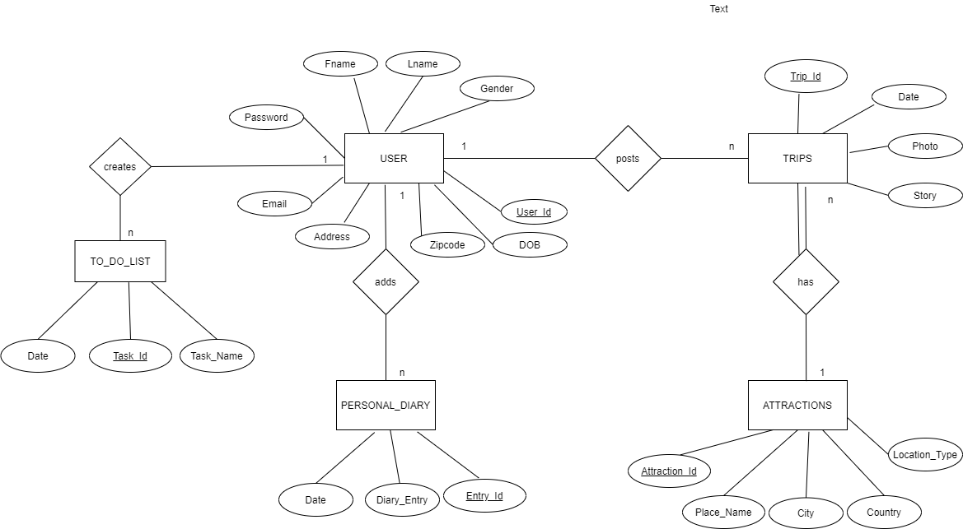
ER Diagram
ER Diagram

Slide 6
Data Acquisition
We generated around 1000 records for the USERS table from a website with URL “http://www.generatedata.com/”. This website generates random data.
We got around 4600 records for the ATTRACTIONS table from a website named Kaggle(https://www.kaggle.com/vitaliymalcev/russian-touris-attractions).

Slide 7
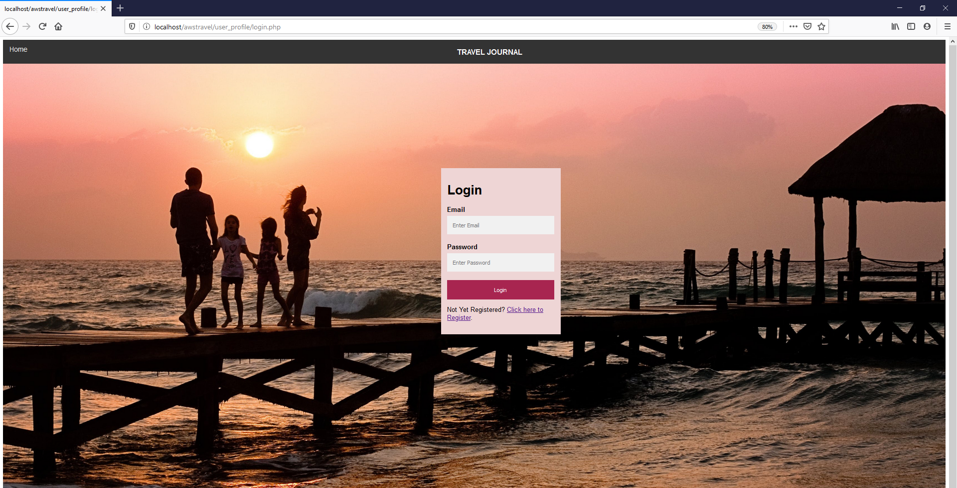
Web Interface

Slide 8
Bonus Part
Go to https://www.awseducate.com/student/s/awssite

